Slide 1

Introduction to AI
Generative AI / AGI
Fabrício Góes

Slide 2
Today, we will talk about (Generative) AI
A very brief introduction to AI
How to interact with AI (Prompt Engineering)
How we’ve been using AI to teach in the last 3 years
What is the University’s policy on the use of AI for teaching
Suggestions on how to integrate AI into your curriculum
AI Teaching Toolkit

Slide 3
Today, we will talk about (Generative) AI
A very brief introduction to AI
How to interact with AI (Prompt Engineering)
How we’ve been using AI to teach in the last 3 years
What is the University’s policy on the use of AI for teaching
Suggestions on how to integrate AI into your curriculum
AI Teaching Toolkit

Slide 4
Setting Expectations
We are not presenting a silver bullet solution to AI detection.
We will share our practical experience on using AI in the BSc in Creative Computing.
Our view is that integrating AI into our teaching practices is very positive.
We assume you may have little experience with Generative AI.
We hope to provide you with a concrete introduction to AI, practical advice (short term) and future directions.
Everything is changing very fast, but we hope to provide you with the most updated state-of-the-art on generative AI and focus on discussing long-term questions and solutions.

Slide 5
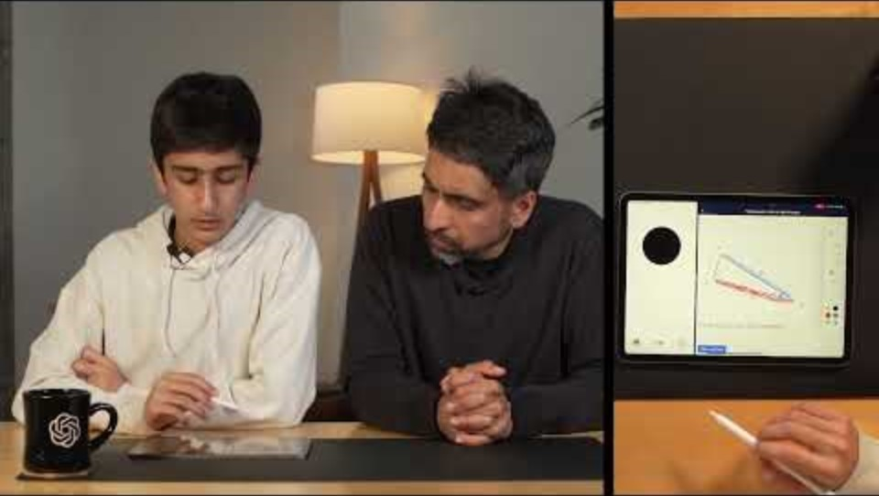

Slide 6
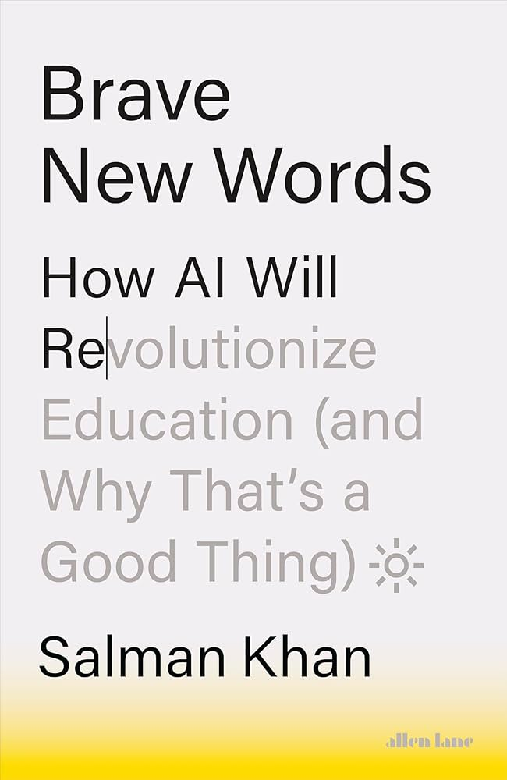
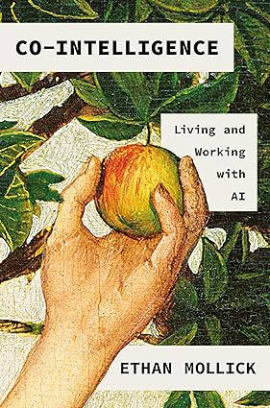

Slide 7
The “2 Sigma Problem”
“In 1984, Benjamin Bloom highlighted the substantial difference in student performance when taught using different instructional methods. Bloom's research demonstrated that students who received one-on-one tutoring performed significantly better than those who learned through conventional classroom instruction.”
(OpenAI ChatGPT, 2024)
Reference List
(OpenAI ChatGPT, 2024 ) OpenAI ChatGPT response to “2 Sigma Problem”, 16th August 2024.

Slide 8
AI might solve the “2 Sigma Problem”
AI tutors are cheap/scalable
AI tutors are available 24/7
AI tutors can be customized for each student’s needs
AI can be prompted to align with the teacher’s style

Slide 9
Other benefits of AI
Partially automate marking and feedback (do the heavy lifting)
Provide reports on student progress
Improve overall quality of students’ submissions
Enable new ways of interactive learning

Slide 10


Let’s talk in the Socratic style
You are a tutor that talks in a Socratic style. You are talking to a student that would like to know more about Generative AI.
What an interesting topic! Generative AI is quite a fascinating field. To start, let me ask you: What do you think "generative" might mean in the context of artificial intelligence?
I have no idea.
Always reply with questions, instead of answers.
That's perfectly fine! Let's break it down together. When you hear the word "generate," what comes to mind? What sorts of things do you think of when something is being "generated"?

Slide 11
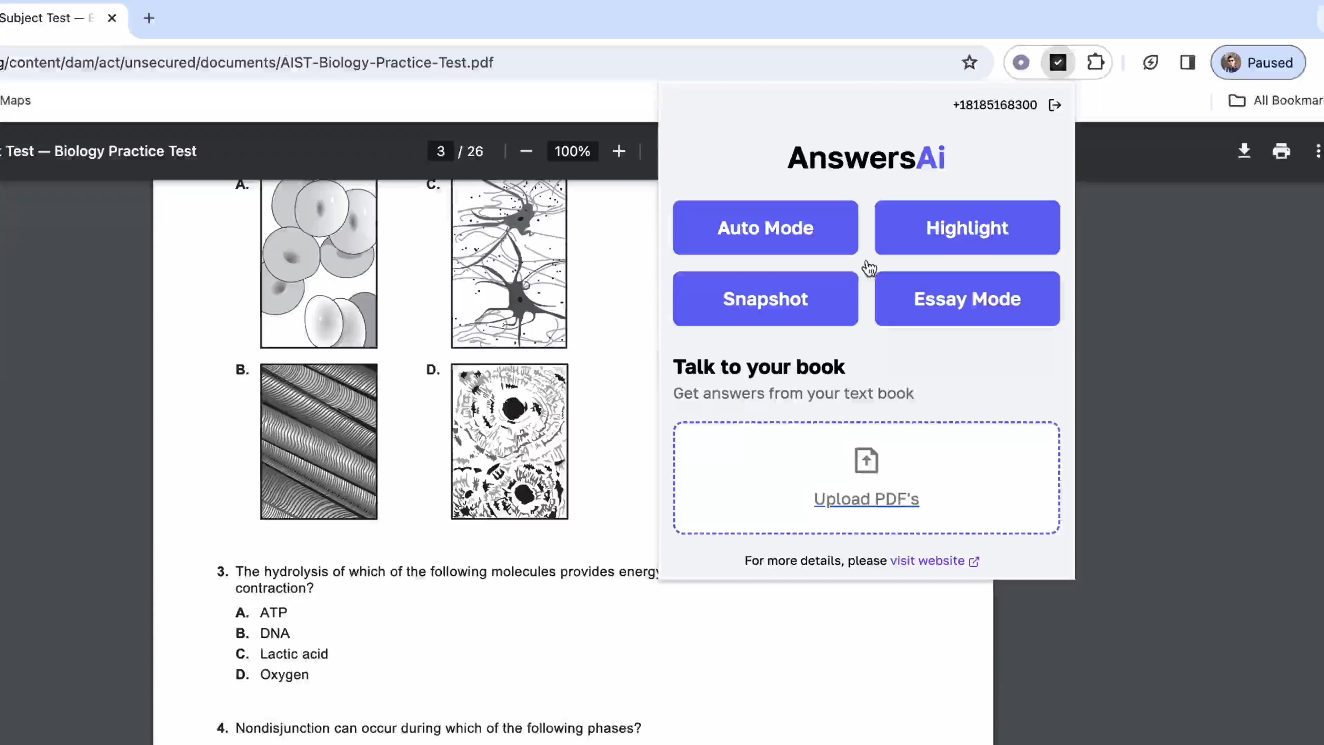
Problems, challenges and risks of using AI
Assessing students’ authorship
Plagiarism
Hybrid submissions (Centaur vs. Cyborg) – how much was done by the student?
Fully AI generated submissions
Copyrights
Personal data sharing
AI alignment (moral values and ethics)
AI responses’ accuracy
Jobs at risk (being replaced by robots)

Slide 12
Essay Generator (Socratic antagonist)
This prompt write a full essay based on a list of legit references as an undergraduate student in academic style.
Act as an undergraduate student, your job is to create an essay in academic style about a topic with a certain word count. I will provide you a list of references and you should use only them. The focus of the essay should be supported by the references provided. It should have a references section at the end in a specific reference style. You should ask me as many questions as necessary to do the job. You should ask one question at a time, and I will respond to each question. When you have enough information to generate the essay, you should generate it. Do you understand?

Slide 13


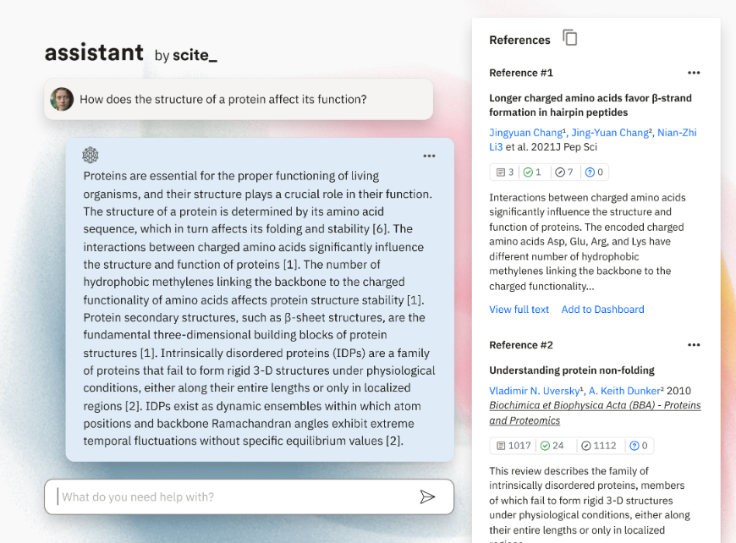
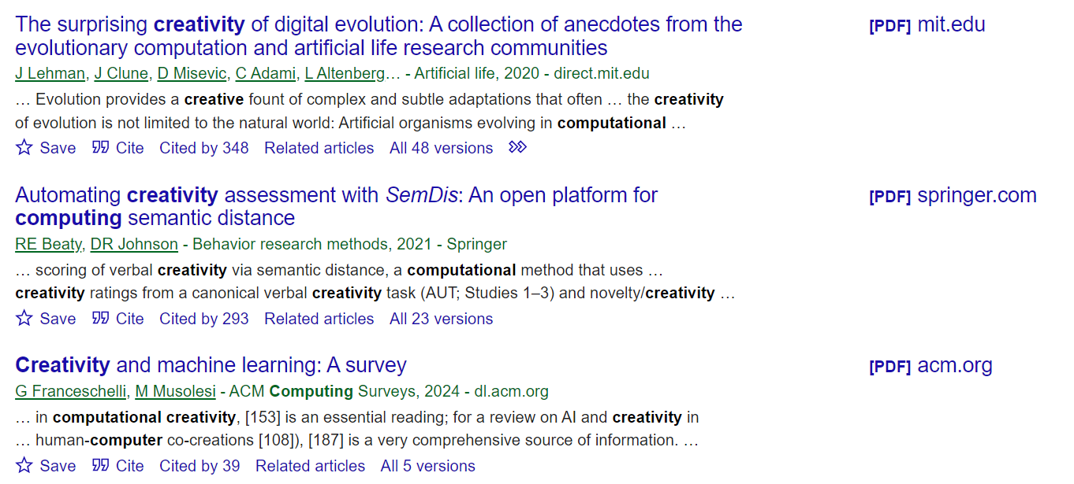
Essay Generator – References List
Current main LLM models make up references. However, you can find legit references list from other AI and non-AI systems and create an essay based on them.
https://scite.ai
https://scholar.google.com/

Slide 14
Full Example – The Impact of AI on Creativity
The Impact of AI on Creativity
Artificial Intelligence (AI) has significantly transformed various aspects of human life, and one of its most intriguing impacts is on creativity. This essay explores how AI influences creativity across different domains, drawing on recent research to illuminate the ways in which computational systems enhance and reshape creative processes.
…
Furthermore, Jordanous and Keller (2016) contribute to the discussion by modeling creativity and identifying key components through a corpus-based approach. Their work provides a deeper understanding of the creative process and how AI can be designed to support various elements of creativity, such as originality and relevance.
References
Brown, A. (2021). Creative partnerships with technology: how creativity is enhanced through interactions with generative computational systems. Proceedings of the Aaai Conference on Artificial Intelligence and Interactive Digital Entertainment, 8(4), 14-20. https://doi.org/10.1609/aiide.v8i4.12555
Jordanous, A., & Keller, B. (2016). Modelling creativity: identifying key components through a corpus-based approach. *Plos One, 11*(10), e0162959. https://doi.org/10.1371/journal.pone.0162959

Slide 15
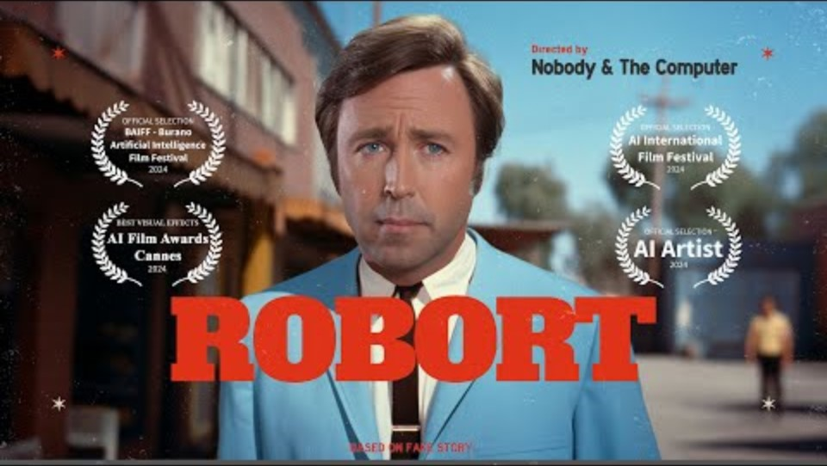
Notes:
This video is a good example how we can use AI to improve our skills. This video also show that we might never be out of the loop, no matter how machines improve.

Slide 16
A Very Brief Introduction to Generative AI

Slide 17
Types of AI
Classic AI
Rule-based systems: Deduction systems based on if/else statements written by developers.
Developers produce the equations, patterns and algorithms.
Modern AI
Machine (deep) learning: Induction systems driven by data.
Artificial neural networks learn equations, patterns and algorithms from data.
Generative AI
Uses the latest artificial neural networks called Transformer models.
Very large neural networks, tons of data, massive processing power.
Notes:
In classic AI, you

Slide 18
How does Generative AI work?
Image all we know is the following text (dataset):
“I love machine learning. I love machine learning. I love cars. I love machine learning. I love machine learning. I love machine learning. I love machine learning. I love machine learning. I love milk. I love machine learning. I love machine learning. I love machine learning. I love machine learning. I love machine learning. I love milk. I love machine learning. I love machine learning. I love machine learning.”
If I ask you to complete the following sentence:
“I love” …
What would be your answer?

Slide 19
How does Generative AI work?
Text-based Generative AI models can predict the next word based on the data they were trained on.
milk | 10%
cars | 5%
machine learning | 85%
I | love | ?
Generative AI is like a super “auto-complete” trained on “all text available in the world”.
An unexpected side-effect of training with a super large dataset was the rise of emergent behaviours.

Slide 20
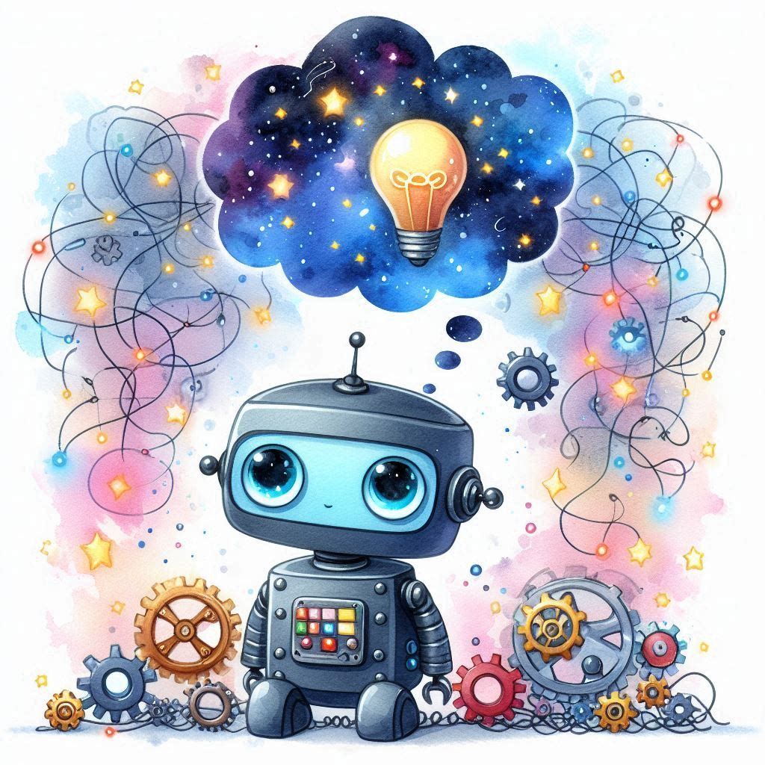
Emergent behaviours
General Reasoning
Critical Thinking / Evaluation
Personas
Empathic Responses
Creativity
Coding

Slide 21
Artificial General Intelligence (AGI)

Slide 22

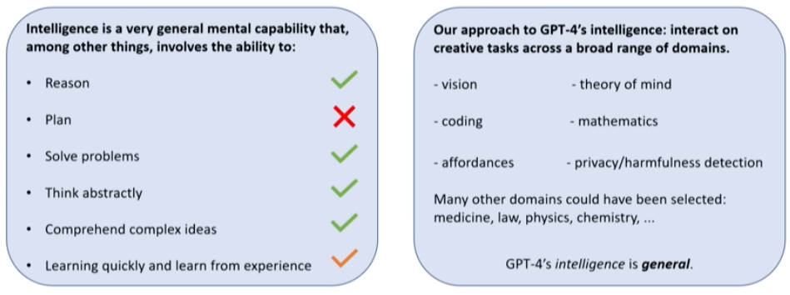
Microsoft Research 2023
https://www.youtube.com/watch?v=qbIk7-JPB2c

Slide 23
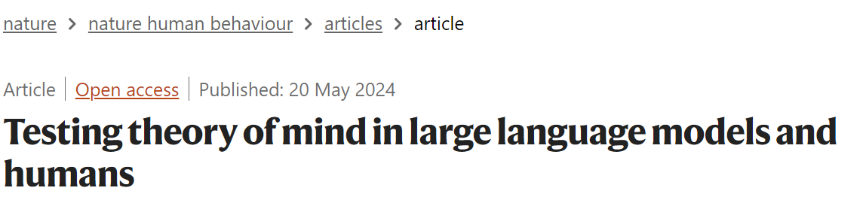
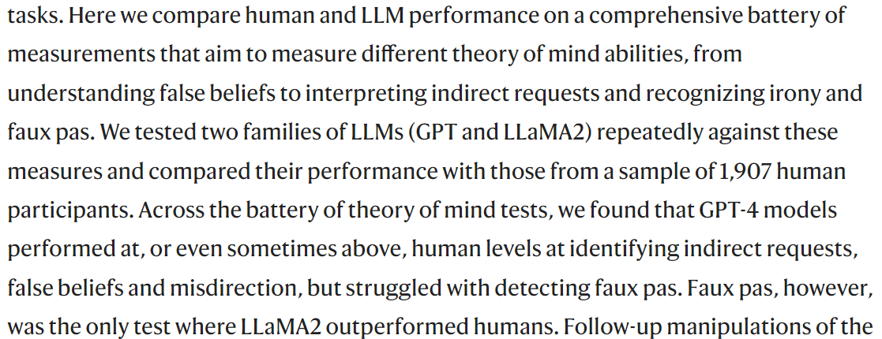
https://www.nature.com/articles/s41562-024-01882-z

Slide 24
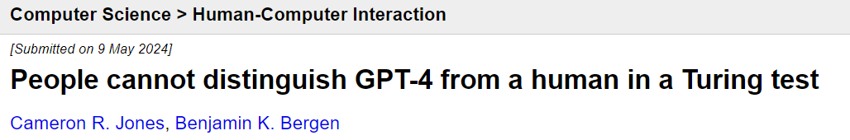
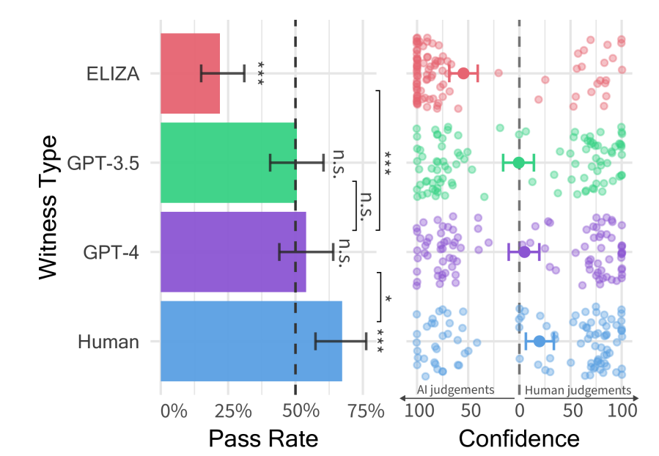
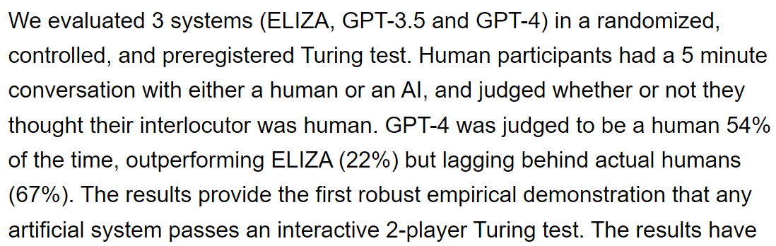
https://arxiv.org/abs/2405.08007

Slide 25
Recent publications
Machine Psychology https://arxiv.org/html/2303.13988v6
The AI Scientist: Towards Fully Automated Open-Ended Scientific Discovery https://arxiv.org/abs/2408.06292
Beyond Human Translation: Harnessing Multi-Agent Collaboration for Translating Ultra-Long Literary Texts https://arxiv.org/abs/2405.11804
Art or Artifice? Large Language Models and the False Promise of Creativity https://arxiv.org/abs/2309.14556
Transcendence: Generative Models Can Outperform The Experts That Train Them https://arxiv.org/pdf/2406.11741

Slide 26
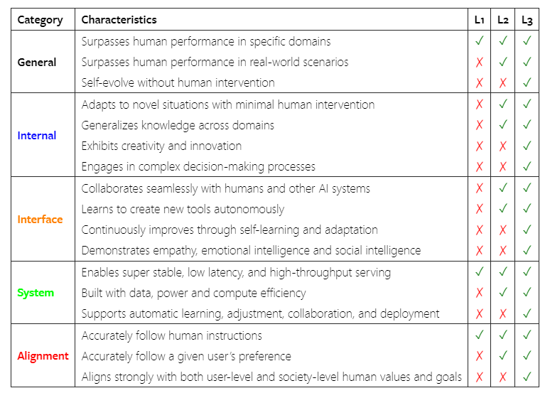
How far are we from AGI (Artificial General Intelligence)?
https://arxiv.org/html/2405.10313v1

Slide 27
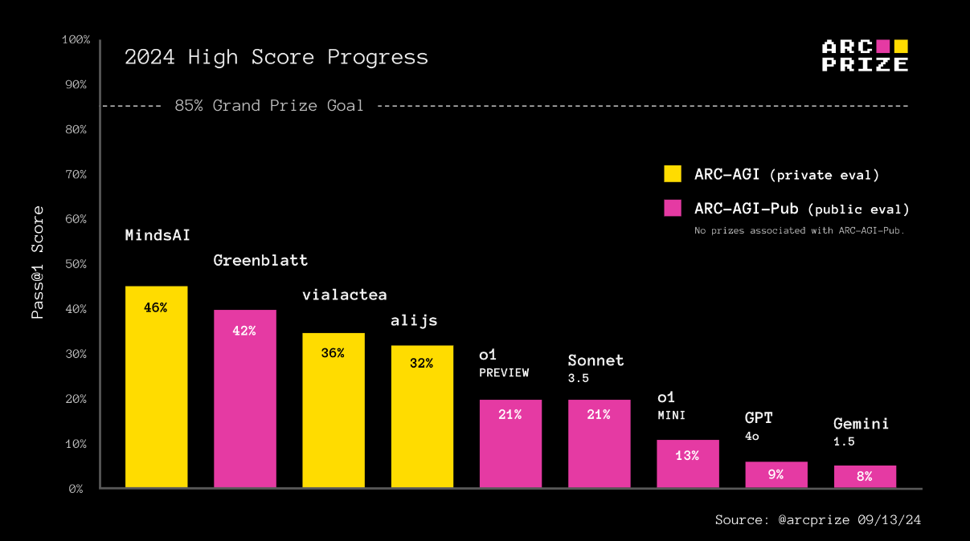
How far are we from AGI (Artificial General Intelligence)?
Intelligence lies in broad or general-purpose abilities; it is marked by skill-acquisition and generalization, rather than skill itself. AGI is a system that can efficiently acquire new skills outside of its training data.
https://arcprize.org/blog/openai-o1-results-arc-prize

Slide 28
Discussion on current AI limitations
“The model you are using now is the worst you will ever use”, Ethan Molick
Exploiting current models weaknesses are very short term solutions
We still cannot believe AI models blindly for tasks we need 100% correct answers. Actually, “LLMs will always hallucinate”: https://arxiv.org/abs/2409.05746
Current models are “intelligent enough”
For long term solutions, it could be wise to assume that those models act like humans (that some level of AGI has been achieved already)
Our focus: How can we take advantage of those intelligent systems?

